Slide 1
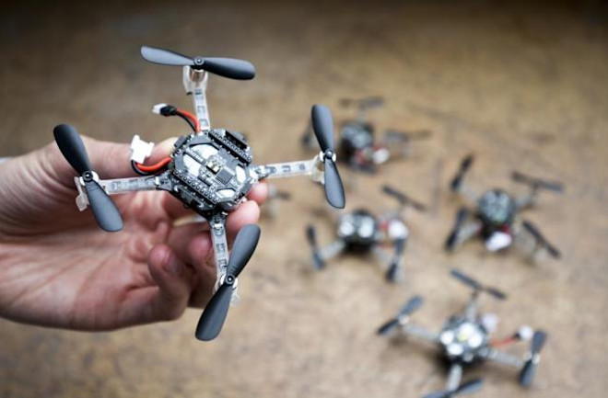
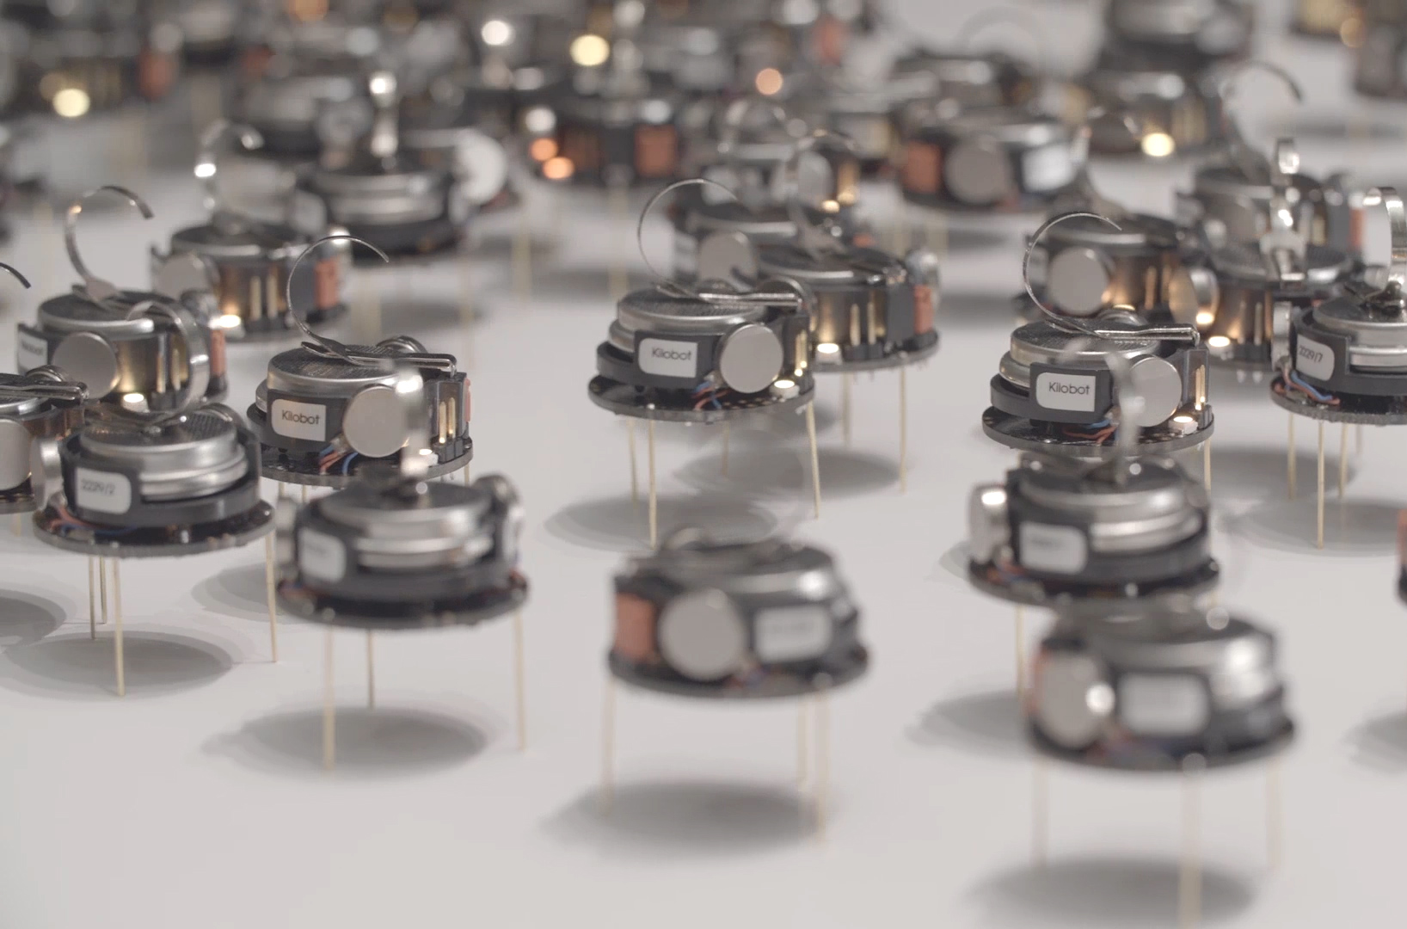
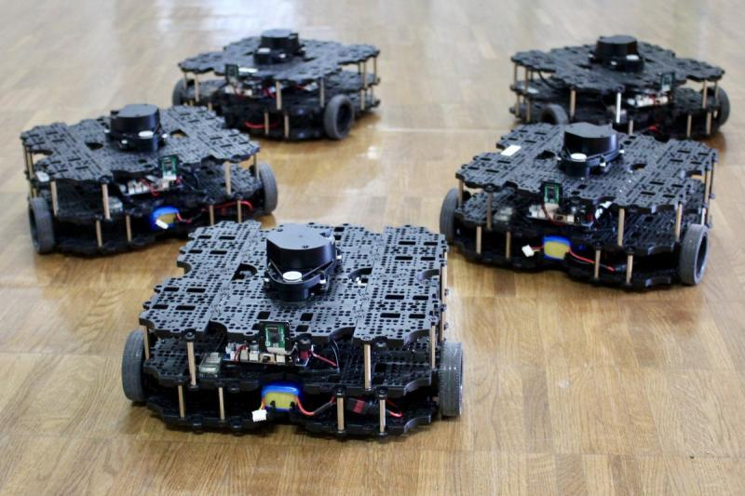

ECE693H, Spring 2025: Multi-robot System Design
“Multi-robot Systems 1”
Dr. Daniel Drew

Slide 2
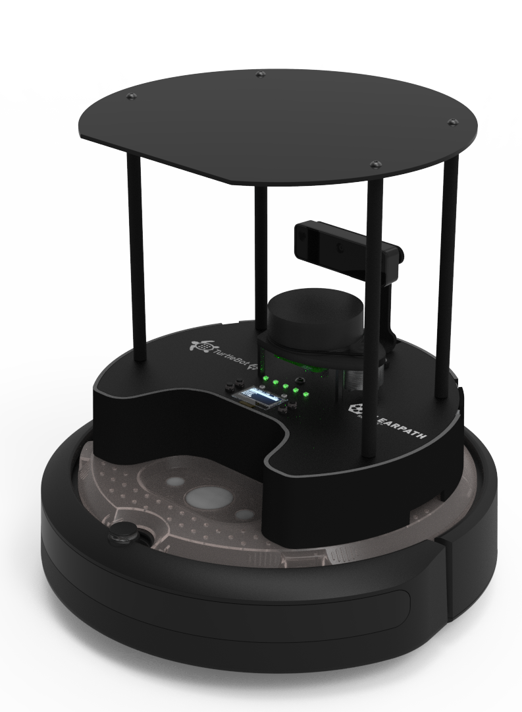

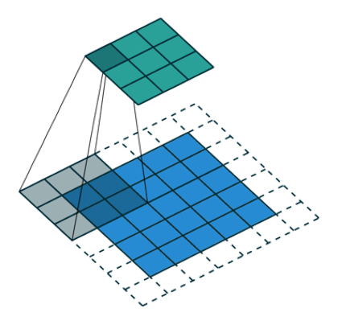
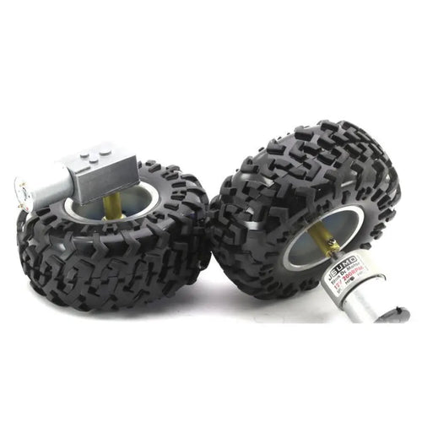
Three Pillars
Action
Perception
Intelligence

Slide 3
Three Pillars
Action
Perception
Intelligence

Slide 4
Questions?

Slide 5
Class Overview
Lecture (~30 minutes)
Subsystem check-in (~30 minutes)

Slide 6
Multi-robot Systems: Lecture 1 of 4
Lecture 1: MRS Survey
Lecture 2: Motion Planning
Lecture 3: Task Assignment
Lecture 3: Communication and Control Paradigms

Slide 7
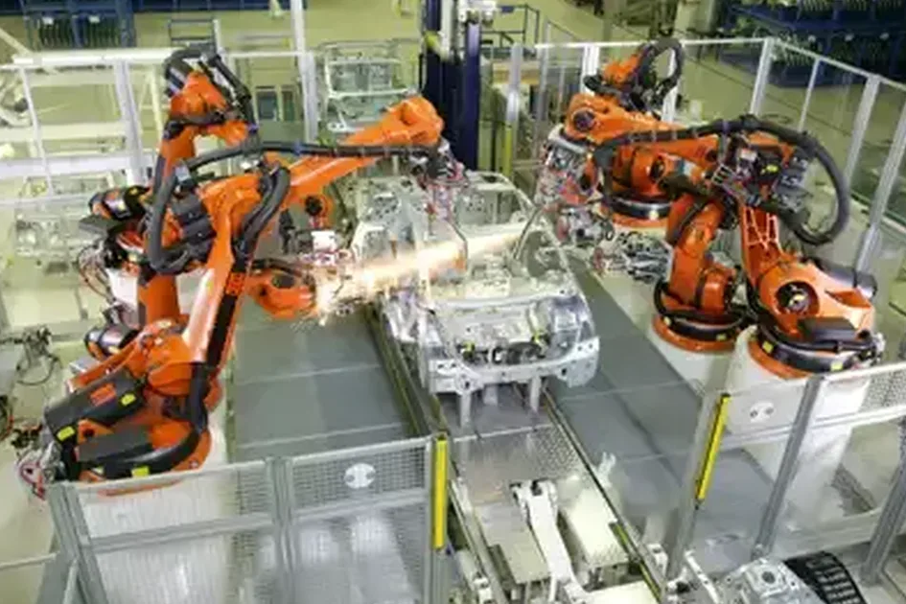
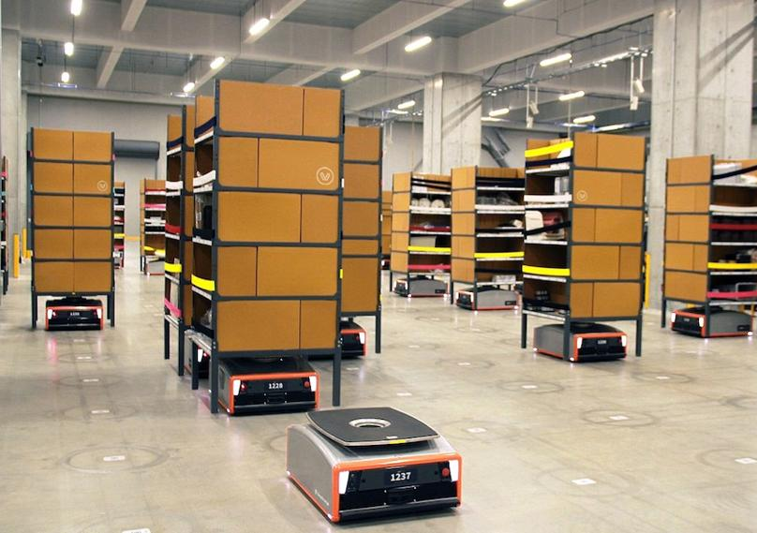
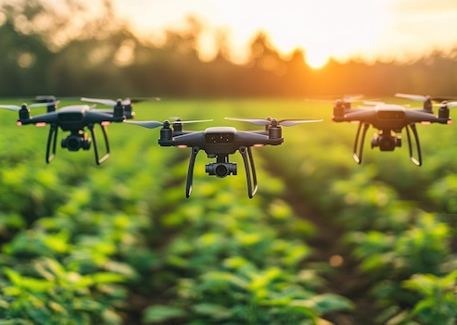
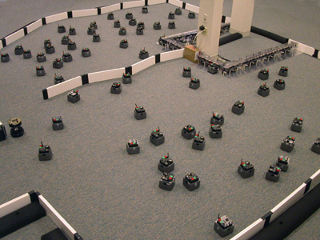
What is a multi-robot system?
A group ( >1 ) of robots with a common objective

Slide 8
What is a multi-robot system?
Mobile Robots
Multi-Robot
Systems
Swarm Robotics

Slide 9
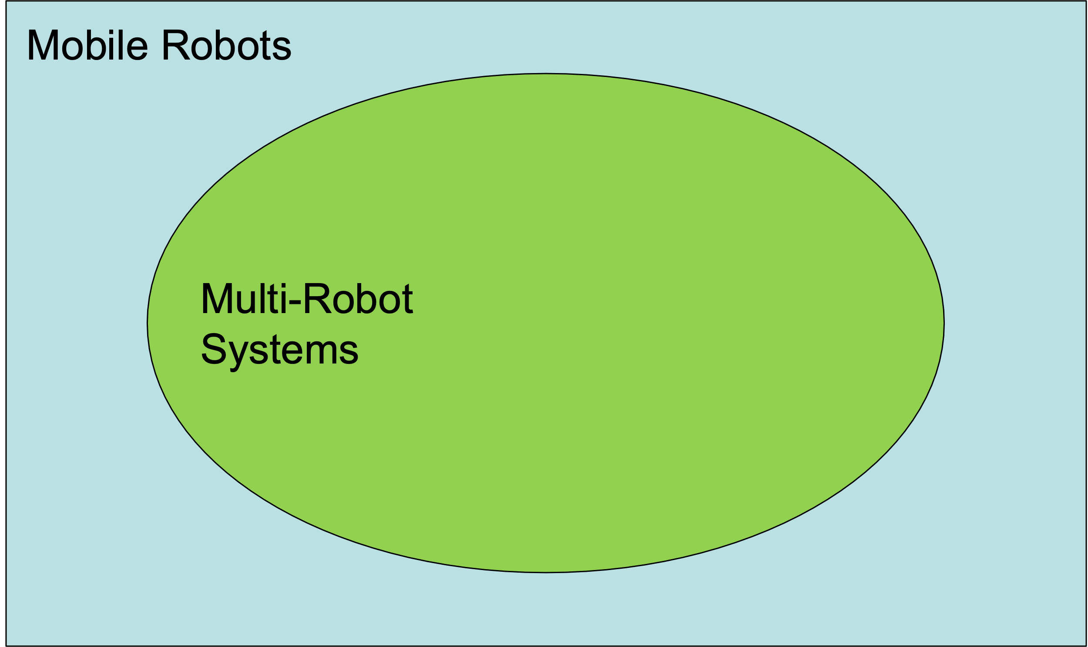
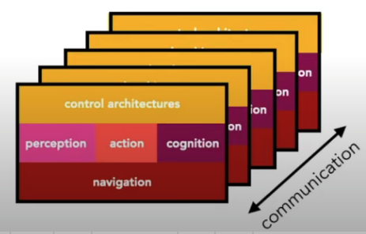
Single Robot vs Multi-robot Systems

Slide 10
Single Robot vs Multi-robot Systems
“Do it all again”, while considering:
multi-robot interactions; compounding probabilities; scaling issues

Slide 11
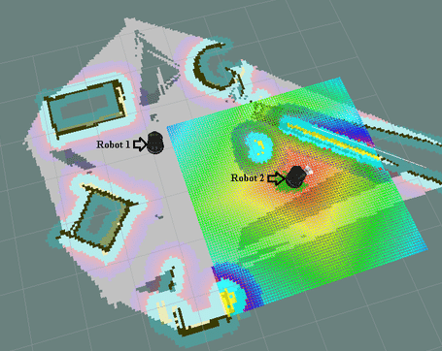
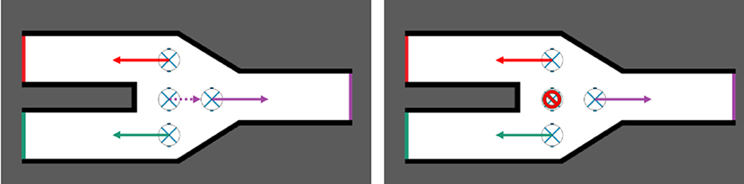
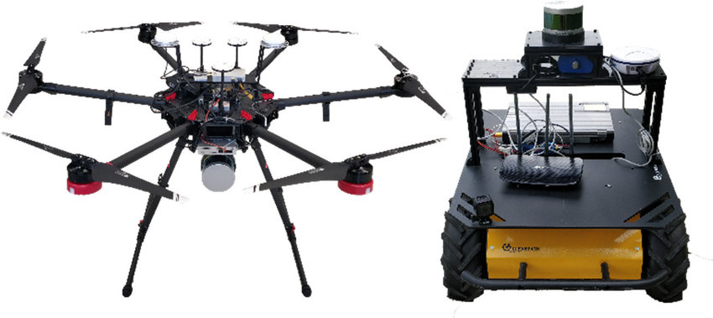
Advantages of MRS
Parallelization: Spatial coverage efficiency
Redundancy: Fault and failure tolerance
Overcoming Platform Constraints: Many cheap, cooperative platforms

Slide 12

MRS in the wild: Warehousing

Slide 13
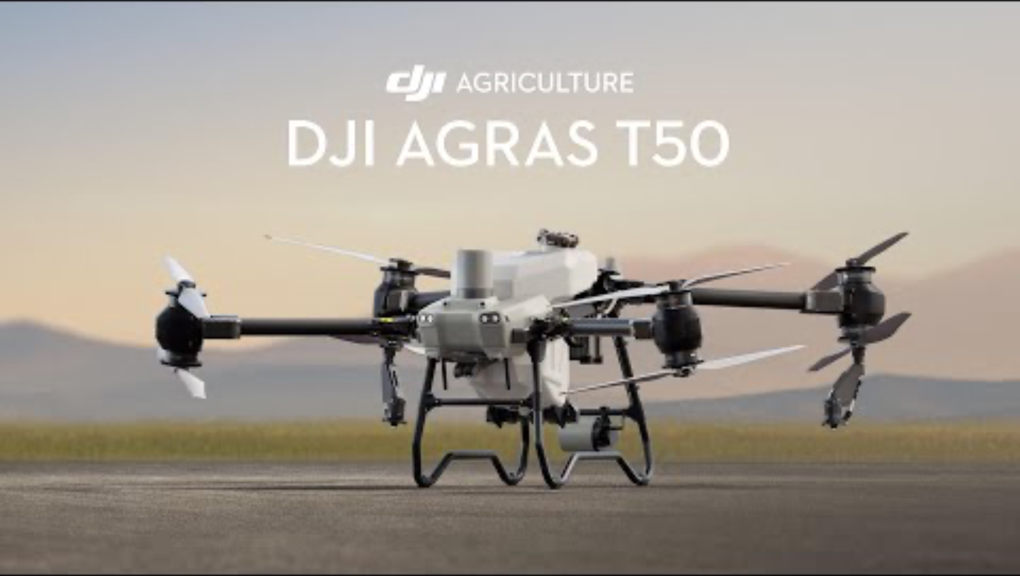
MRS in the wild: Agriculture

Slide 14
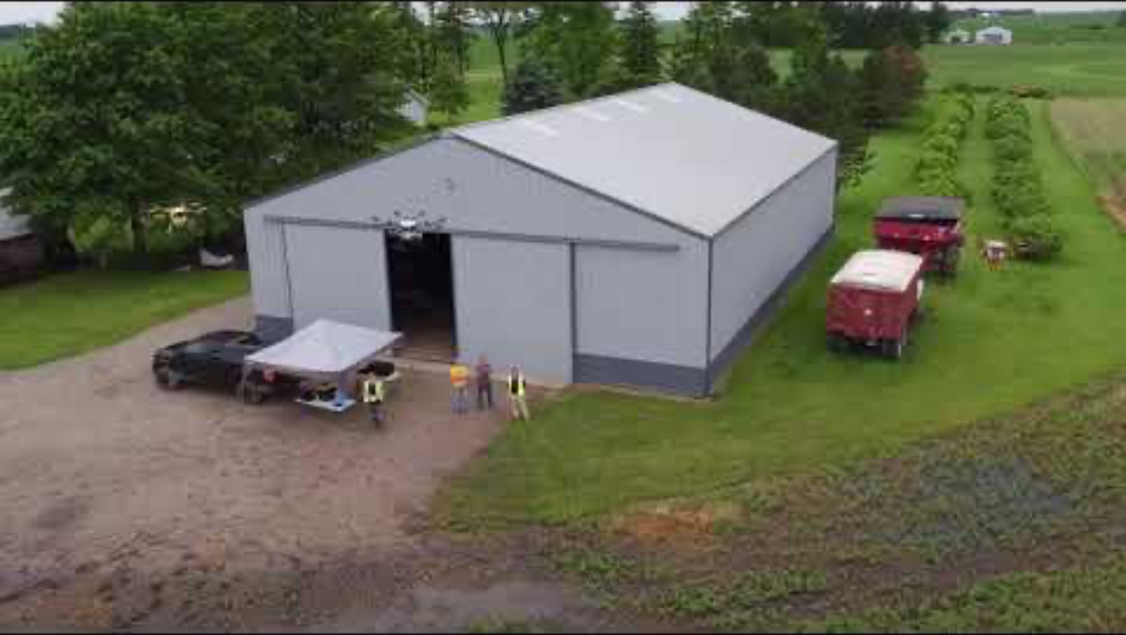
MRS in the wild: Agriculture

Slide 15
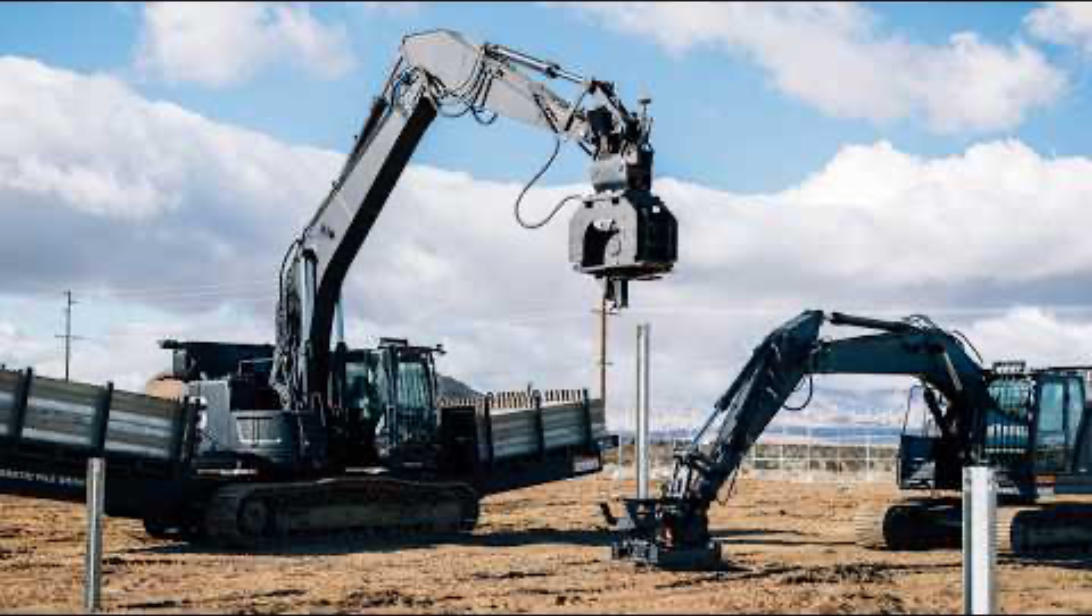
MRS in the wild: Construction

Slide 16

MRS in the wild: Inspection

Slide 17
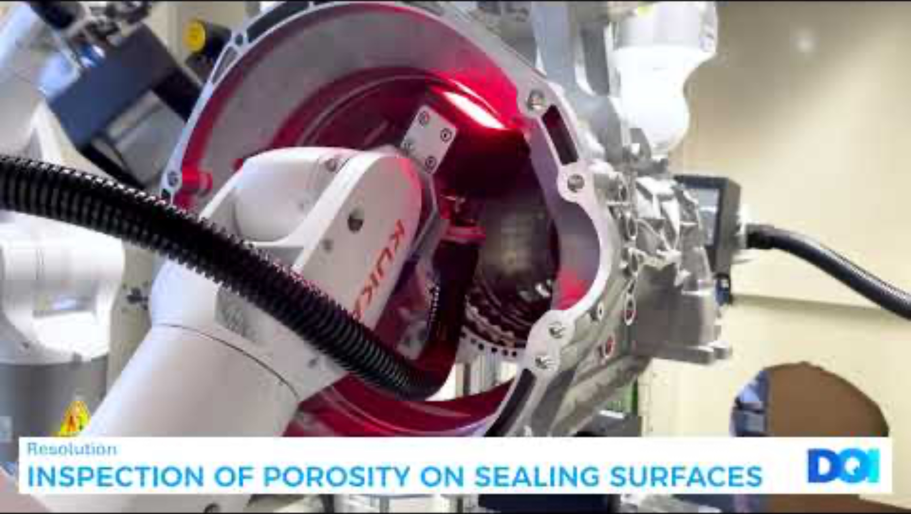
MRS in the wild: Inspection

Slide 18
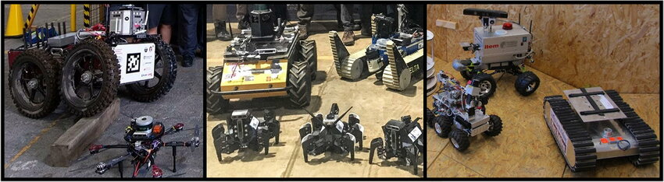
MRS in the wild: Search and Rescue

Slide 19

MRS in the wild: Defense and Intelligence

Slide 20
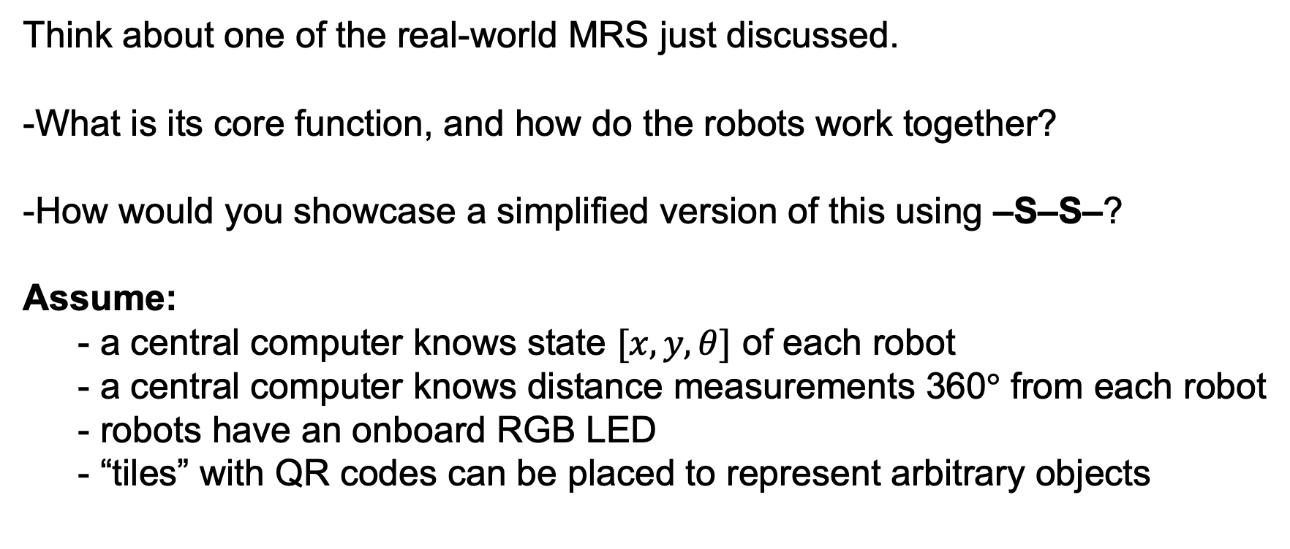
In-class Activity: Swarm-on-a-Stick Brainstorm
Think about one of the real-world MRS just discussed.
-What is its core function, and how do the robots work together?
-How would you showcase a simplified version of this using –S–S–?
Assume:
- a central computer knows state $[x,y,θ]$ of each robot
- a central computer knows distance measurements 360$°$ from each robot
- robots have an onboard RGB LED
- “tiles” with QR codes can be placed to represent arbitrary objects

Slide 21
Multi-robot System Taxonomy
Control
Centralized: One central unit performs estimation and planning, then communicates with all robots to issue commands.
Decentralized: Individual agents make asynchronous control decisions based on their current best information.
Communication
Explicit: State information and observations are directly sent to/between robots, e.g., using WiFi
Implicit: Information is exchanged through common observations of the environment
Composition
Homogeneous: All robotic platforms are the same.
Heterogeneous: Robotic platforms may differ in payload, mobility, etc.

Slide 22
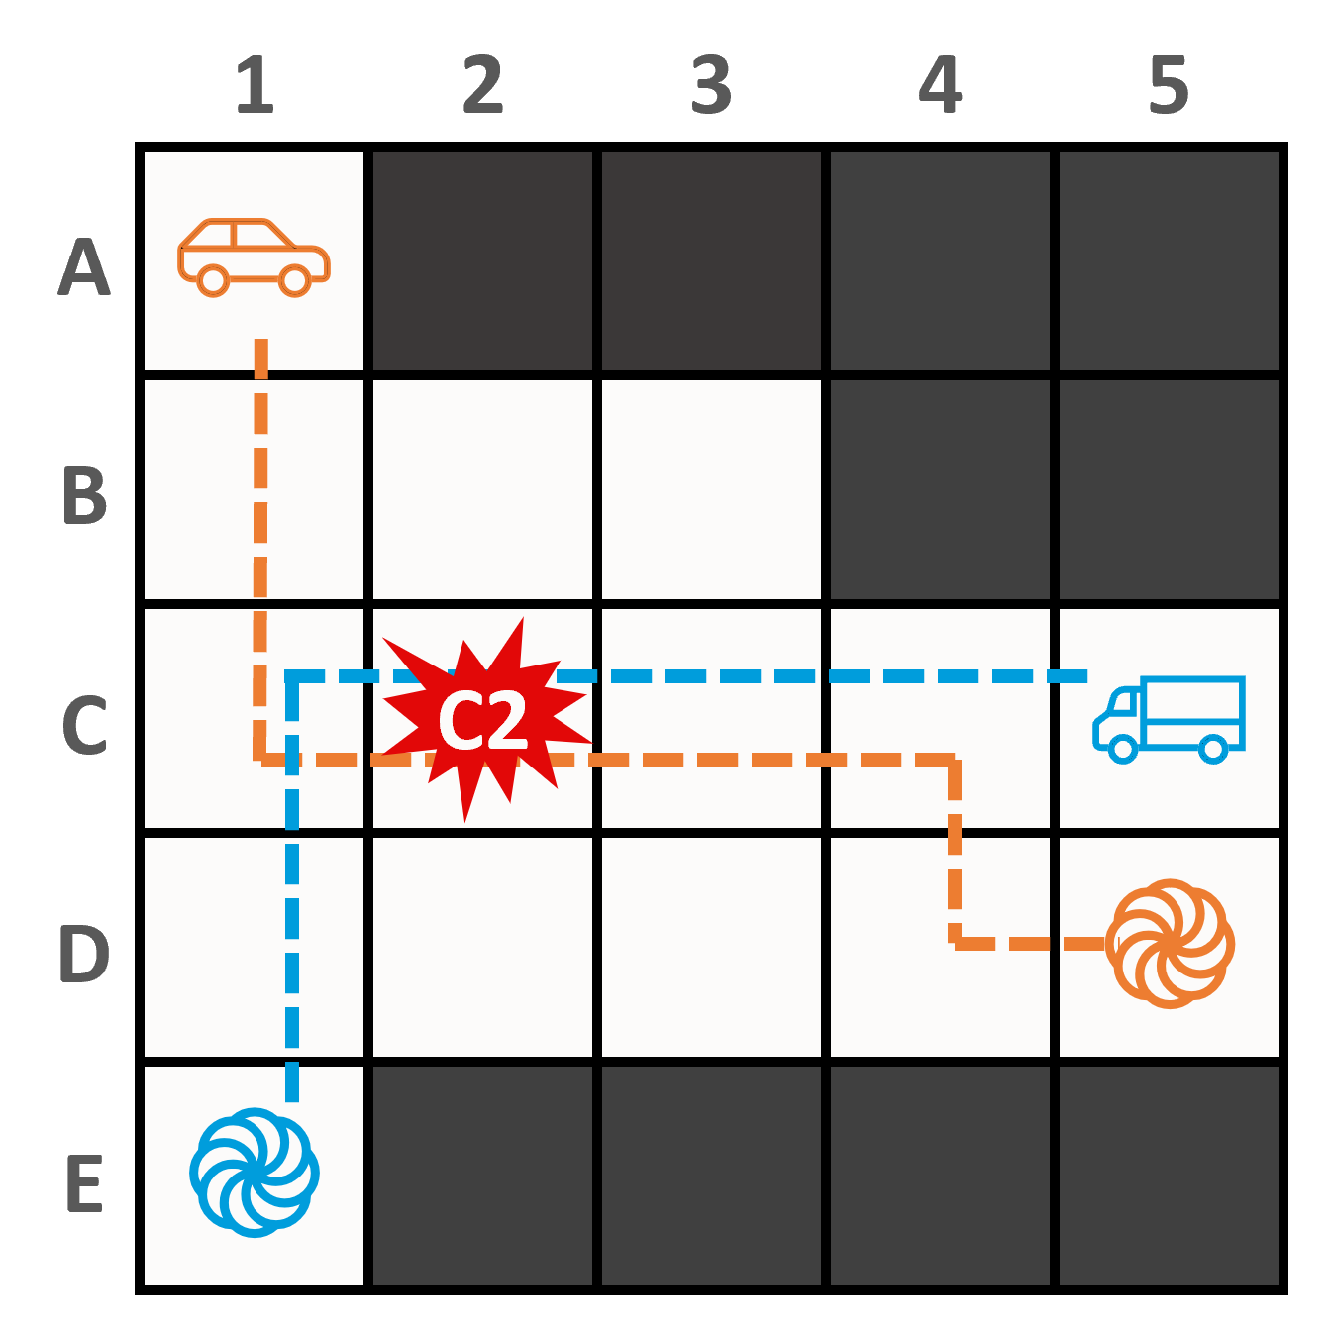
Key challenges in MRS: Motion Planning
compounding uncertainty; motion dynamics become necessary; environmental changes cascade; computational complexity (NP-hard)

Slide 23
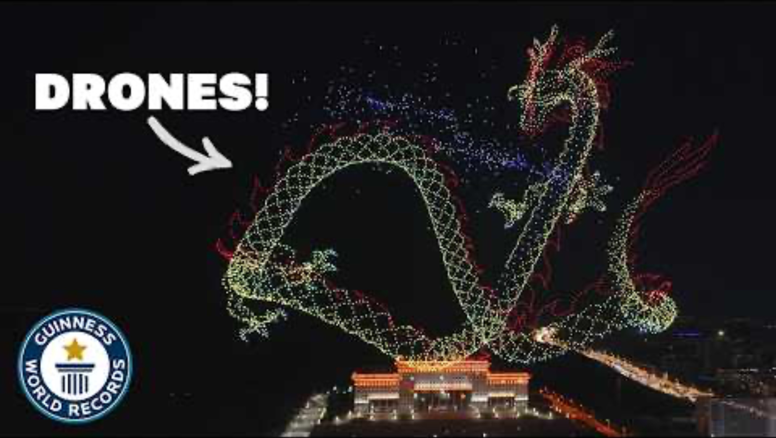
Key challenges in MRS: Motion Planning

Slide 24
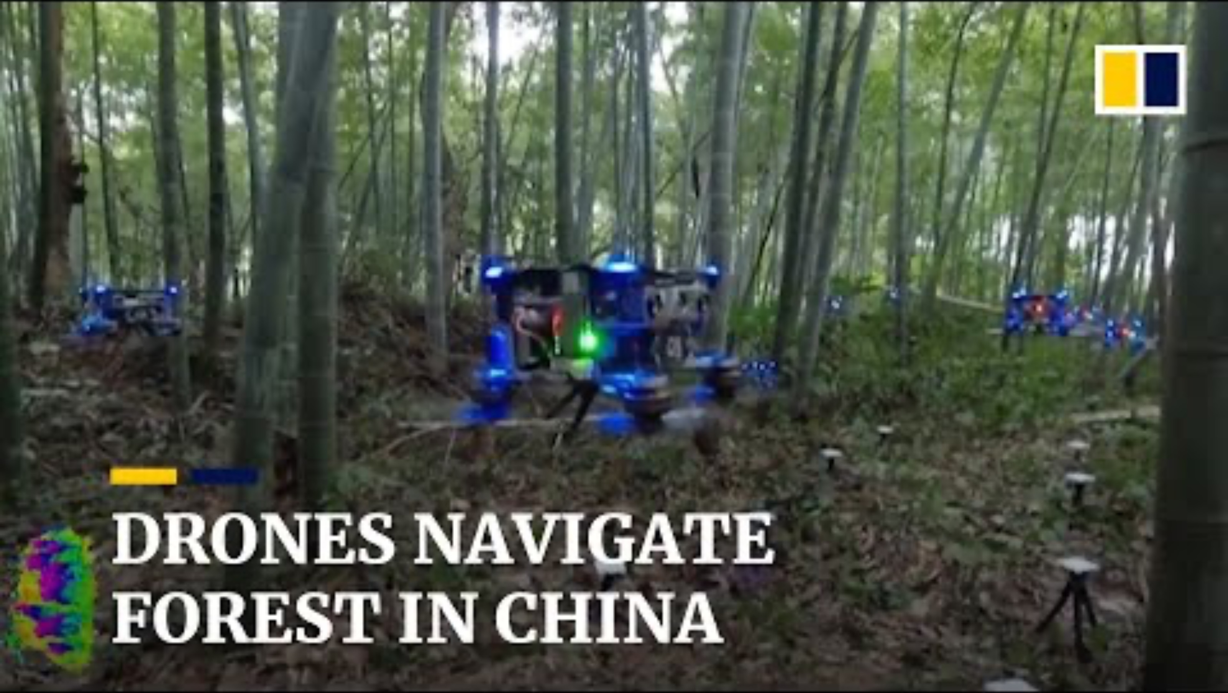
Key challenges in MRS: Motion Planning

Slide 25
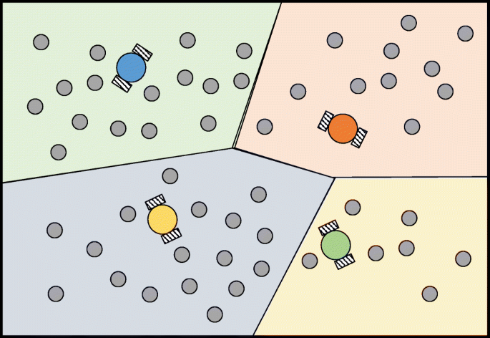
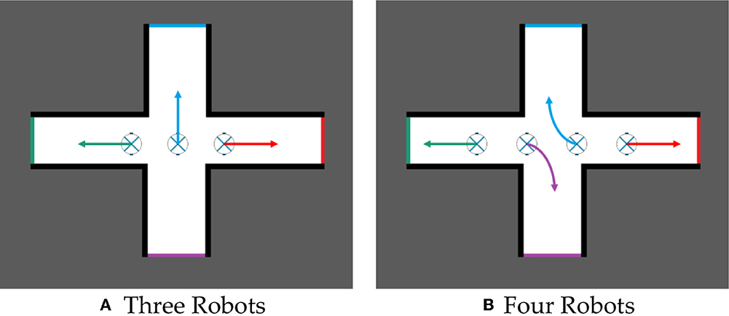
Key challenges in MRS: Task Allocation
compounding uncertainty;
computational complexity (NP-hard);
task interdependency and prioritization

Slide 26
Key challenges in MRS: Task Allocation

Slide 27
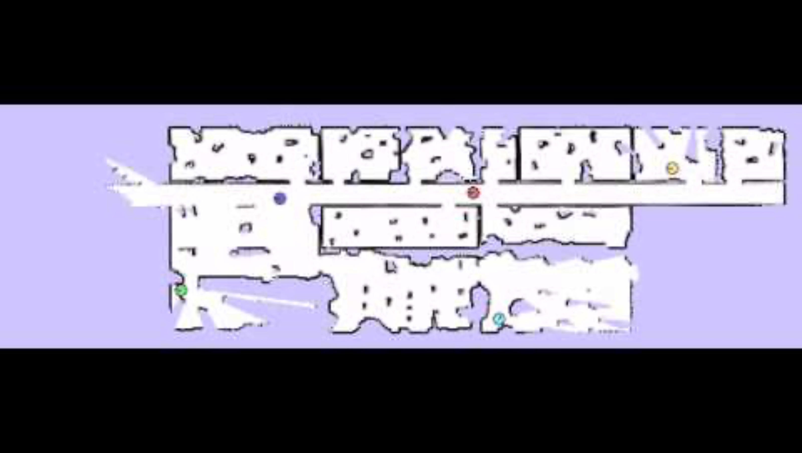
Key challenges in MRS: Task Allocation

Slide 28

Key challenges in MRS: Information Exchange
network throughput limits; connectivity changes from motion;
variable environmental factors (e.g., obstacles); power consumption

Slide 29
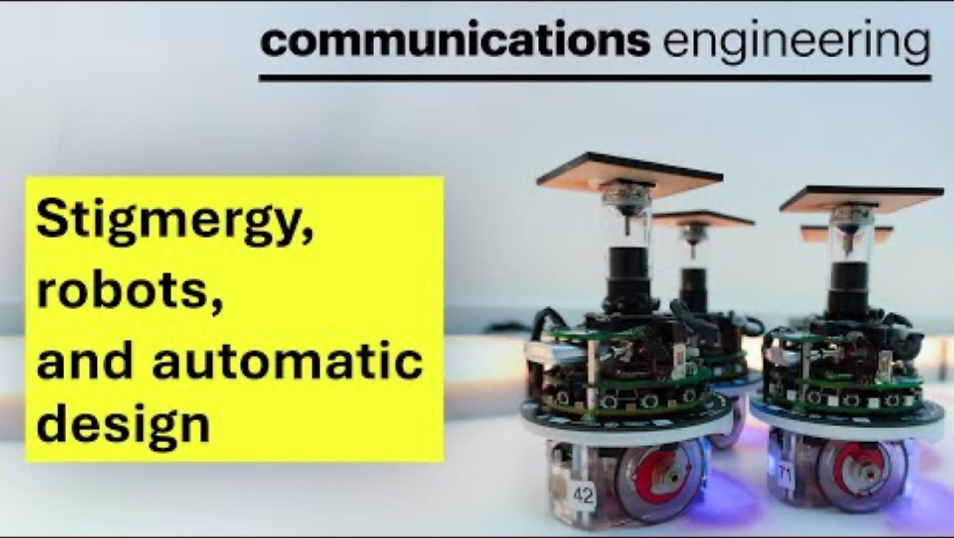
Key challenges in MRS: Information Exchange

Slide 30
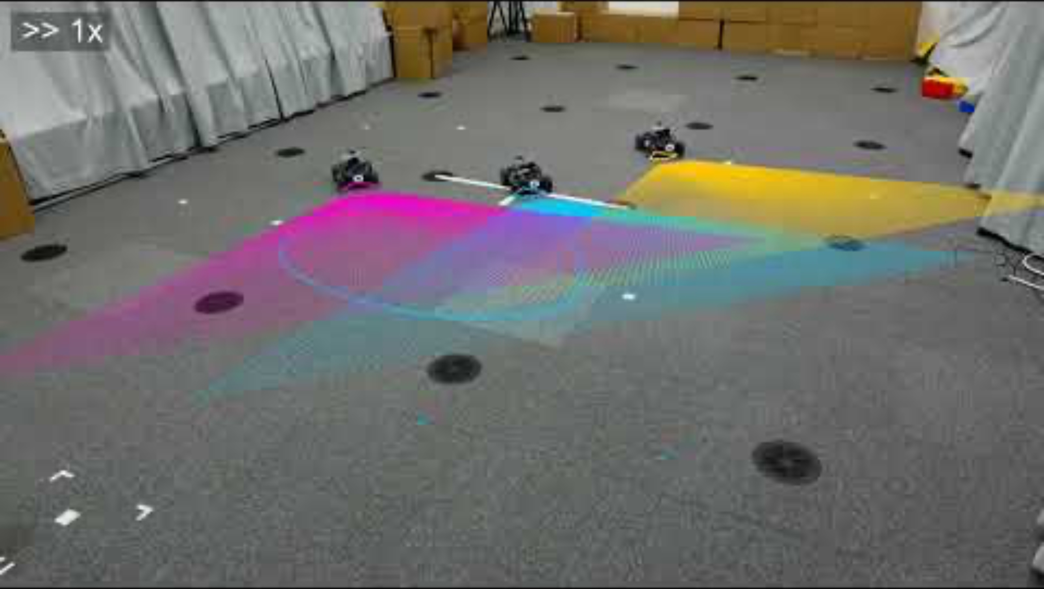
Key challenges in MRS: Information Exchange

Slide 31
Tying back to Swarm-on-a-Stick
How will we make sure our robots do not collide when moving?
How will we decide which robot does what?
How will each robot be controlled?
How will our robots communicate?

Slide 32
Lecture (~30 minutes)
Subsystem check-in (~30 minutes)
Questions?
Questions?
Lecture 1: MRS Survey
Lecture 2: Motion Planning
Lecture 3: Task Assignment
Lecture 3: Communication and Control Paradigms

Slide 33
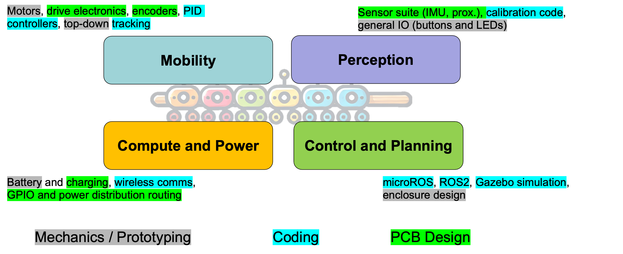
693H Robotic Subsystems
-Second Design Review Presentations are 3/10, 3/12
-You will be expected to have functional prototypes complete to show by then
-You will be expected to have PCB designs and final BoMs complete by then
Astound-the-Class 2 is scheduled for MONDAY, MARCH 3rd

